Slide 1
10ALYTICS GROUP 3 PROJECT
YAKUB ISMAIL IMRAN
OYENIYI ELIZABETH
BAKARE OLALEKAN

Slide 2
EXECUTIVE SUMMARY
We worked on a dataset called supermarket sales data of customers buying 6 different products around three different cities/branch using 3 different mode of payment..
Exploratory data analysis was carried out to analyze the supermarket sales data in order to make recommendations on how to boost sales across the different product-line in the various cities.
Out of the three cities Naypyitaw city had the highest revenues of sales with females being the highest buyer.

Slide 3
DATA SET DESCRIPTION
We explored the data for insights by first carrying out data cleaning and understanding. The Data had 1000 rows and 17columns which was later cleaned to 15 columns and 1000 rows. It was recorded that there were no missing cells found and most of the data were in object data-type .
Further cleaning done included changing some column names for better understanding E.g ( ‘cogs’ was renamed to cost of goods sold and some columns were dropped)
The data given include: Invoice no, cities(yagon, naypidaw, mandalay) , branches(A,B,C), gender(Male, female), customer type(member / normal) product line(about 6), date , time, payment, cost price and total.
The products sold in the supermarkets are divided into 6 categories namely: Health and beauty, Electronic accessories, home and life style, sports and travel, food and beverages ,fashion accessories.
Mode of payment in the supermarket were Cash, E-wallet and credit card.

Slide 4
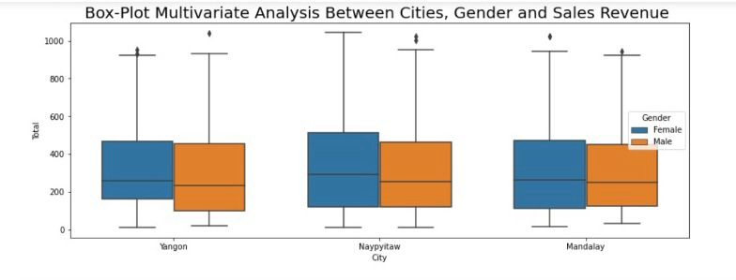
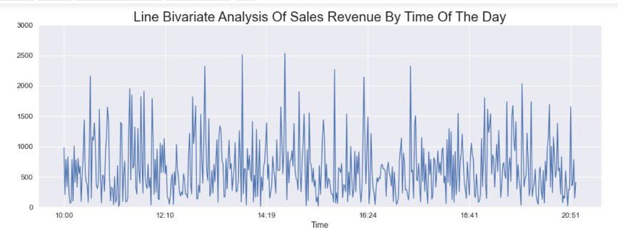
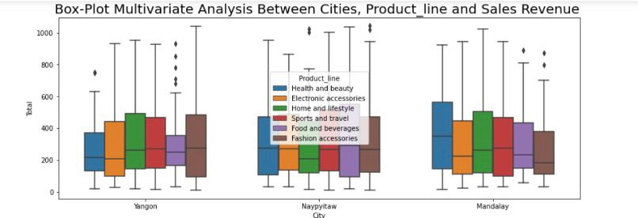



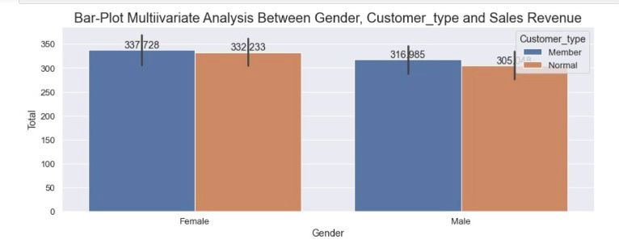
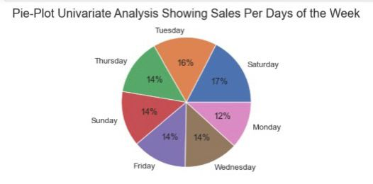
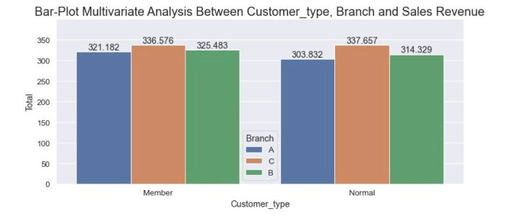
VISUALIZATION
Yagon
Naypidaw
Mandalay
cities
Time
Female
Gender
Male
Member
Normal
Customer type

Slide 5
CONCLUSION
Percentage of female customers buying products from the supermarket was relatively higher than that of male customers in all the locations. Napyitaw was the location with the highest sales revenue.
Customer type under the member’s category accounts for a larger percentage than that of normal customer types in sales revenue.
Saturday and Tuesday have the highest sales revenue between the hours of 2 pm to 4 pm. Therefore, it is recommended that Sales promotion and advertisement be targeted on Saturday and Tuesday between the hours of 2pm to 4pm to boost sales revenue.
In Yagon people bought home and lifestyle products the most , for Naypyitaw it was food and beverages and at mandalay it was health and beauty products.
Further insights can be explored in the notebook - https://github.com/lamibakers/SUPERMARKET-SALES-EXPLORATORY-DATA-ANALYSIS

